Slide 1


Slide 2






Team Introduction
Random Forest Gump

Slide 3





Outline
PROBLEM STATEMENT
DATA CLEANING AND TREATMENT
EXPLORATORY DATA ANALYSIS
MODEL SELECTION
SHINY APP

Slide 4
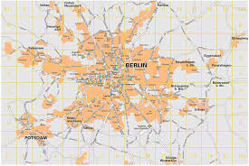
Problem Statement
Each listing is UNIQUE.
Predicting the price for an Airbnb host’s new listing in Berlin, Germany.
What additional features a host can offer to command higher prices?
The following questions will drive this project –
What are the features that affect pricing of the listing?
Based on the features, can we determine a fair price for a new listing that fits into its specific market environment and competitors in Berlin?
Most popular city in Germany
Size – 891km²
Average 25 homes/ km²
Notes:
Airbnb hosts find it difficult to set up prices to keep when listing a new property.

Slide 5
Outline
PROBLEM STATEMENT
DATA CLEANING AND TREATMENT
EXPLORATORY DATA ANALYSIS
MODEL SELECTION
SHINY APP

Slide 6
Data Cleaning & Treatment
Step 1 – Removing unwanted variables.
Original Data Frame has 22522 observations and 96 variables
Based on business understanding, irrelevant parameters were removed
Using DataQualityReport, identified columns with Null values (More than 40% Null values) and dropped them.
Notes:
Taken data from Kaggle which consists details of Airbnb host’s listings from 2009 to 2018.

Slide 7
Data Cleaning & Treatment
Step 1 – Removing unwanted variables.
Step 2 – Treatment of Numerical and Categorical Variables
WHY & HOW?
Since, the data is standardized with each predictor variable having mean 0 and standard deviation 1, there are outliers in the dataset.
We used replacement node in SAS Enterprise Miner to cap and floor the values to -3 and +3.
Input file is the up-sampled one obtained from Python.
Numerical Variables – All numerical variables are appropriately classified into interval (numeric) class.
Categorical Variables – All categorical variables are appropriately classified into nominal and ordinal class, as necessary.
→ Missing values treated using Mode.
Date Variables – All date variables are formatted in ‘DD-MM-YYYY’ format.

Slide 8
Data Cleaning & Treatment
Step 1 – Removing unwanted variables.
Step 2 – Treatment of Numerical and Categorical Variables
Step 1 – Removing unwanted variables
Step 3 – Outliers Treatment
Capped the values above 2 Standard Deviations of Mean
Floored the values below 2 Standard Deviations of Mean

Slide 9
Outline
PROBLEM STATEMENT
DATA CLEANING AND TREATMENT
EXPLORATORY DATA ANALYSIS
MODEL SELECTION
SHINY APP

Slide 10
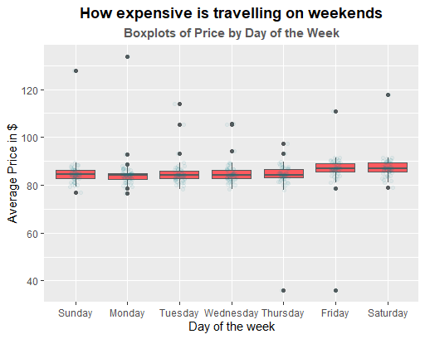
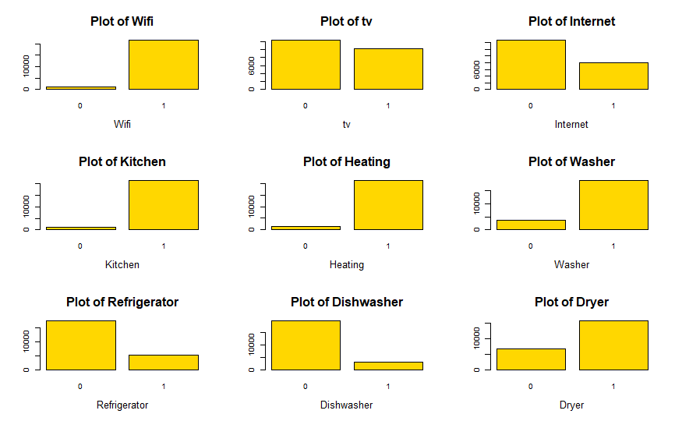
Exploratory Data Analysis
Price are higher on Fridays and Saturdays compared to other days of the week
Analysis of amenities in existing Airbnb listings at Berlin.
TV and Internet has significant values for comparison

Slide 11
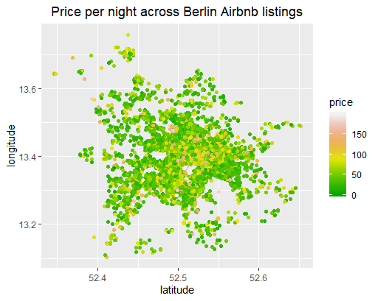
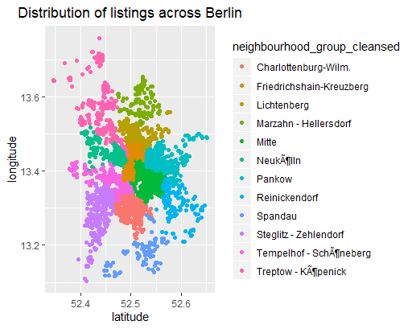
Price per night and Neighbourhoods of Berlin
Notes:
Fair idea about pricing in berlin city. Very few houses having higher price, which is at the heart of the city.

Slide 12
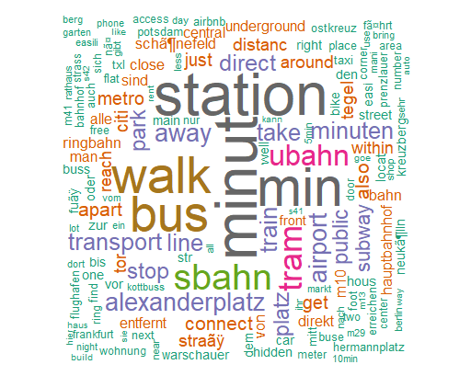
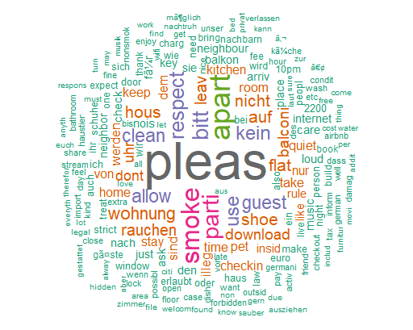
Text Analysis
Transit/ Connectivity
House Rules
Notes:
Text analysis based on existing database. It will help a new host to set his house rules and location based on connectivity.

Slide 13
Outline
PROBLEM STATEMENT
DATA CLEANING AND TREATMENT
EXPLORATORY DATA ANALYSIS
MODEL SELECTION
SHINY APP

Slide 14
Data Modelling
Model 1 – Multiple Linear Regression
Using all variables, we created a Multiple Linear Regression to predict price of the house
Divided the dataset into Train (80%) and Test (20%)
RMSE on Test dataset = 22.896

Slide 15
Data Modelling
Model 1 – Multiple Linear Regression
Model 2 – Random Forest Regression
Using RandomForest with Number of Trees = 500, extracted important variables that influence the price of the property.
Using these variables, built future models for prediction.
Important Variables selected through Random Forest are RoomType, CleaningFee, Bedrooms, Neighbourhood_Group, Beds, Bathrooms, Cancellation Policy, TV and Internet.
RMSE on Test dataset = 22.621

Slide 16
Data Modelling
Model 1 – Multiple Linear Regression
Model 2 – Variable Selection using Random Forest Regression
Model 3 – Gradient Boosting Regression
WHY & HOW?
Since, the data is standardized with each predictor variable having mean 0 and standard deviation 1, there are outliers in the dataset.
We used replacement node in SAS Enterprise Miner to cap and floor the values to -3 and +3.
Input file is the up-sampled one obtained from Python.
Built a Gradient Boosting model (GBM) with Number of Trees = 1000.
Used Cross Validation test with 10 folds to test the RMSE on the test dataset.
RMSE on test dataset = 22.579
Selected Gradient Boosting model based on lowest test RMSE

Slide 17
Outline
PROBLEM STATEMENT
DATA CLEANING AND TREATMENT
EXPLORATORY DATA ANALYSIS
MODEL SELECTION
SHINY APP

Slide 18
References
R shiny layout:
https://shiny.rstudio.com/articles/layout-guide.html
https://www.rdocumentation.org/packages/shinybootstrap2/versions/0.2.1/topics/fluidPage
Word Clouds:
https://datascienceplus.com/building-wordclouds-in-r/
ggplot:
https://ggplot2.tidyverse.org/reference/scale_gradient.html

Slide 19
THANK YOU

